Slide 1


Slide 2
Marketing & PR
Where to begin?

Slide 3

It starts with you!
Testimony: Your existing members sharing their experience with friends, peers/coworkers, family, and yes, even strangers are your greatest tool.
Encourage your members to consider their “why” to help them be prepared for when an opportunity presents itself.

Slide 4

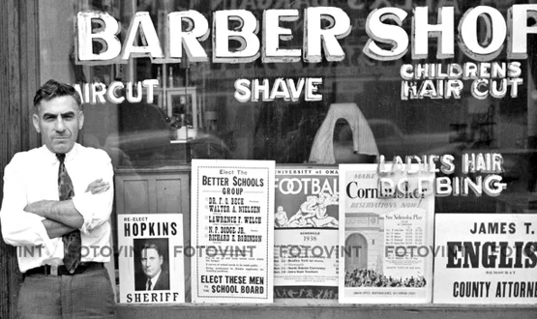
Print and Digital Resources
Printed brochures or business cards.
Does anybody use these?
Is the ROI worth it?
Digital Marketing/Ads
Pay for results: Google SEO, Facebook/Instagram, X, TikTok ads
Organic results: Your website, social media, YouTube

Slide 5
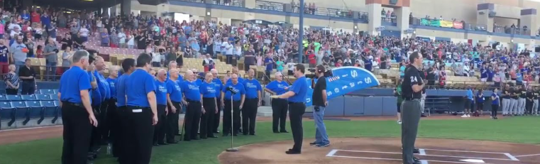
Demonstrate
Not just your chapter/chorus produced shows
Community Sing-outs
Teach a Tag
Community Events
Volunteer

Slide 6

Consider Your Audience
Internal

Slide 7
External
District/
Chapter/
Chorus
Friends/Family
Colleagues/
Acquaintances
Sponsors
Singers
Church
Community
Connections

Slide 8

Help Us, Help You
Shows
Guest Night
Projects and Community Involvement/Engagement
Follow Up (foster FOMO)
Share Photos, Flyers, or Videos on our social media and to webmaster@rmdsing.org

Slide 9
Your Website is your Primary Source of Information

Slide 10
Who is Visiting Your Site?
Fans
Potential Members
News/Media
Other Chapters/Barbershoppers/Singers
The District
Notes:
Fans: have seen you, know about you
New Members: People looking for you. How I found SOR
News Media: Do you notify local media about shows? If so how can they learn more about you
Other Chapters/Barbershoppers/Singers: Can visitors from out of town find you and join your rehearsal?
The District: How can the district find out about what you have going on?

Slide 11
Website Content
Who are you?
Where do you meet, and at what time?
Calendar: Rehearsals, Shows, Chapter/Chorus Events, Chapter Meetings
Chapter News: Community Outreach, content from shows, contests (upcoming or results)
Contact Information: Request Information, Book the Chorus, Book a Quartet
What is Barbershop?
Quartet Feature Page: List chapter quartets with their contacts and socials
E-Commerce: Merch, CDs, Ticket Sales
Notes:
What is your goal? Community, competition, comraderie?

Slide 12
Keep your content current
Post events as they are planned
Share new information on social media
Inform the District about your events so we can help promote them!!!

Slide 13
Social Media
The most connected
THE source for information in more and more peoples’ lives
Build and Strengthen online followings and relationships
Create community and connectivity around your chapter/chorus

Slide 14




Facebook
X (twitter)
Instagram
TikTok
Notes:
83% of TikTok users in the U.S. are under the age of 45. 71% of X users are under 45, though its’ popularity has gone down substantially since switching from Twitter (15th ranked social media platform), 75% of Instagram users in the US are under the age of 45, 61.8% of Facebook users are under the age of 45.

Slide 15
How can you get involved with Social Media?
Follow the District and other Choruses on Social Media to see what they are doing.
Utilize FAQs and video tutorials
Designate one person from your chapter to run your socials.
No one stepping up, or nobody confident they can manage it? Consider partnering with local high school or university to find a student who is willing to be a Social Media Manager Intern.

Slide 16


